Slide 1
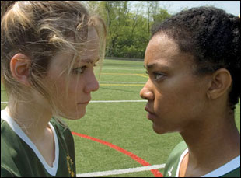
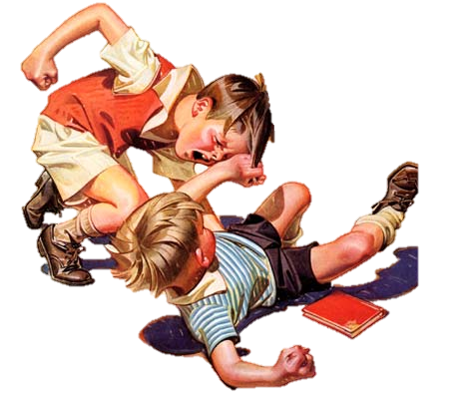
Understanding and Treating Angry, Aggressive Children and Adolescents
Jim Larson, Ph.D.

Slide 2
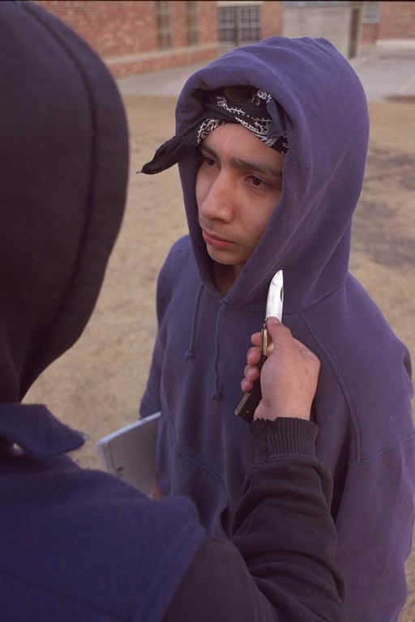
Proactive/Premeditated Aggression
goal-oriented aggressive behaviors; want something
cool-headed, bully-type; gang leadership
overvalued use of aggression
managed best with effective security measures

Slide 3
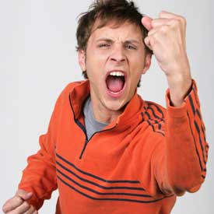
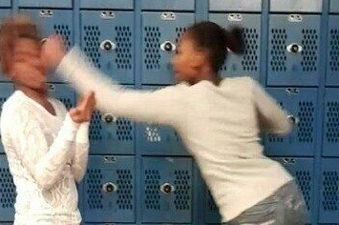
Reactive/Impulsive Aggression
Unplanned, impulsive
Hot tempered, easily riled
Show less control over emotions

Slide 4
Continuum v. Dichotomous
Reactive Proactive
E.g. Bushman & Anderson, 2001
Continuum
Dichotomous
E.g., Dodge, 1991
Reactive
Proactive

Slide 5
Exacerbating and Risk Factors for Reactive Anger and Aggression
High risk pregnancy
Young, poor prenatal nutrition, substance abuse
Often results in low birth weight
Difficult temperament
Coercive parenting style (Patterson et al.)
Limited discipline responses
Poor child monitoring
Attack-Counterattack -Positive Outcome
Escalating counterattacks
Notes:
Tobacco -- emotion regulation problems and Inter-Uterine Growth Retardation
Cocaine – aggression
http://www.socialsciences.leiden.edu/educationandchildstudies/clinicalchildandadolescentstudies/neurocognitive-development/research/prenatal-risks.html
Difficult Temperament – strong genetic predisposition; Chess and Thomas’s work ;
Fussy, demanding, hard to warm up to

Slide 6
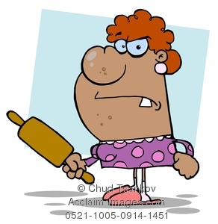
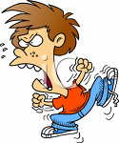
Attack – Counterattack – Positive Outcome
“All right! All Right! Take it easy! Just keep the noise down, okay?"
“Stop hitting your sister!”
“No! She started it!!”
Parent makes a compliance demand
Mother’s escape behavior is reinforced & child’s antisocial behavior is reinforced
Repeat.…

Slide 7
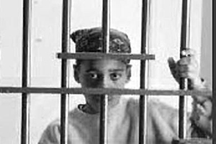
The Path Continues…
Poor readiness and peer rejection in school
Academic difficulties, retention, and/or special education
Co-morbid ADHD, ODD, trauma reaction
Middle school brings exposure to other high risk or deviant peers
Lack of prosocial models and supervised community activities
Gang involvement possible
Alcohol, drugs, and weapons

Slide 8
Family breakup
Marital relationship
Neighborhood
Extended Family/
Friends
Parent Psychopathology
Workplace Environment
Socioeconomic disadvantage
Parenting and other relationships with child/youth
Middle
Childhood
Adolescence
Infancy
Pre-Natal
Early
Childhood
School
Skill deficient, off-task, aggressive, rejected by teacher and peers, low support of positive behavior
Home - Child
Disobedient , aggressive, no role in family organization
Parent
Eroding discipline and monitoring, little involvement in school or peers
School
Fights, bullies, no homework, academic failure, no connection, substance use, early sex, delinquency, social cognitive deficits
Teachers
Give up; multiple suspensions
Home
Combative with parent, no discipline, less time at home, antisocial peers, low supervision
Parents
Poor parenting skills lead to negative potentially abusive interactions, high stress, low social support
Child
Temperament
Health status
Mother
Smoking/
Substance abuse
Nutritional/health care
Home
Coercive or inconsistent
discipline
Poor monitoring,
poor reinforcement,
child rejection
Child
Antisocial behavior
Adapted Reid & Eddy, 2002
Conduct Problem Developmental Model

Slide 9
Social Information Processing (Dodge, 1991; Crick & Dodge, 1994) OCCURING IN A SPLIT SECOND…
attend to available social cues
give meaning to the cues
select desired outcomes
Generate possible responses
Identify potential consequences of a response
act out selected responses
Hallway passing stimuli, brushed on shoulder
Scan memory; Prior hallway experiences
Avoid trouble; Get to class on time
Call him out; Keep moving to class
Possible trouble; Get to class w/out incident
Think about something else and head for class
Notes:
To the audience – “You are attending to my voice now. You’re going to learn something. You take notes to meet that goal.”
The kids we are talking about have processing deficits. They don’t deal well with these 6 steps.
Jim’s joke: “I know you do well with these steps, because you’re not in jail ☺”
9

Slide 10
Social Information Processing Deficits in Reactive Aggressive Youth (Dodge, 1991; Crick & Dodge, 1994)
attend to available social cues
give meaning to the cues
select desired outcomes
Generate possible responses
Identify potential consequences of a response
act out selected responses
Hypervigilant for aggressive cues
Hostile attributional biases
Higher value on retaliation than affiliation
Narrow solution generation abilities
Tendency to evaluate aggression positively
Difficulty enacting prosocial skills
Notes:
To the audience – “You are attending to my voice now. You’re going to learn something. You take notes to meet that goal.”
The kids we are talking about have processing deficits. They don’t deal well with these 6 steps.
Jim’s joke: “I know you do well with these steps, because you’re not in jail ☺”
10

Slide 11
Reactive Aggressive Youth Implications for Treatment Interventions
Social-Cognitive Deficit
Hypervigilant for aggressive cues
Hostile attributional biases
Higher value on retaliation than affiliation
Narrow solution generation abilities
Tendency to evaluate aggression positively
Difficulty enacting prosocial skills
Training Focus
Train verbal & nonverbal cue recognition
Attribution re-training
Consequential thinking
Solution generation skills
Perspective-taking development
Behavioral skills training
Notes:
Point 1. Reactive kids look for someone rolling their eyes or that shoulder bump, -they are looking for hostile cues.
Example – you’re walking down the hallway and you accidentally bump someone. You turn around and (trainer holds palms up and mouths the word ‘sorry’). Reactive kids do not pay attention to the cue of hands up, rather they are still focused on the shoulder bump.
Point 2. This is the tendency to judge a neutral stimulus as hostile
Point 3. They have a great desire to get back and someone than to make friends. The teacher may say ‘make up and shake hands’ but these kids later will want to get even.
Point 4. Example. Driving down the highway and someone ahead of you is driving 20 miles/hour below the speed limit. Many possible solutions: lay on the horn, flip them off, bump up behind them…. but I took a deep breath
Show video – boy dribbling a soccer ball and another boy comes and kicks the ball into the street. What to do? I’ll beat the crap outta him! I’ll kick his head in! I’ll get my cousin to… Want to get kids to a point that they see value in assertive but non aggressive responses – “hey, go get my ball”
What we do in these interventions is help kids look at and think about the consequences
We usually tell kids to ignore, or take a deep breath. They SAY they can do it, but in action they cannot.
Example – If our training today were about how to fly, I could get you to the point that you would pass the (written) test. You can learn all ABOUT flying an airplane but not how to actually DO it. We need to TEACH these kids through practice, practice practice…
TRAINING FOCUS
- You all know when you’re getting angry and then you regulate
- You think about the situation – could it have been an accident (that so and so did that)? Maybe he confused me with someone else.
(consequential thinking) If I do this then what would happen?
(sol’n generating) What could I do?
(Persp) What might she have been thinking? If you were that teacher what would you be thinking. (this is the first step in empathy development)
(skills training) actually TEACH them things such as being assertive. These are skills they do not know
11

Slide 12
Anger and Reactive Aggression
Cognitive, affective, and behavioral aspects
Anger cognitions; demandingness; fairness
You don’t get from anger to aggression without the cognitive attribution of intentionality
Physiological sensation of anger
Tendency to over-label arousal as anger
Behavioral - verbal, physical, otherwise
Interventions should focus on all three
Notes:
.”
12

Slide 13
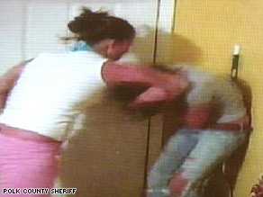
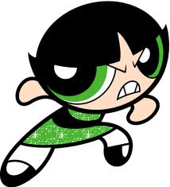
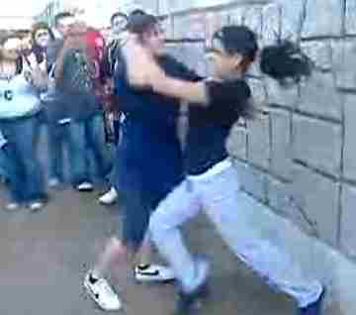
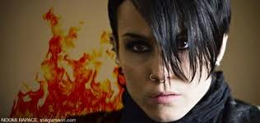
Rates of arrests for assault among girls have climbed steadily since the 1990’s
180,000 murders, rapes, armed robberies, and assaults on TV over typical childhood viewing period (Garbarino, 2006)

Slide 14
Physical Aggression in Girls
Physically aggressive girls are at comparatively higher risk as a group
Favor older, aggressive boys
Begin sexual relationships early
High risk for physical abuse
Most of their fighting is about boys or about perceived disrespect
Girls who have been physically and/or sexually abused in the home are at increased risk to be physically aggressive in school

Slide 15
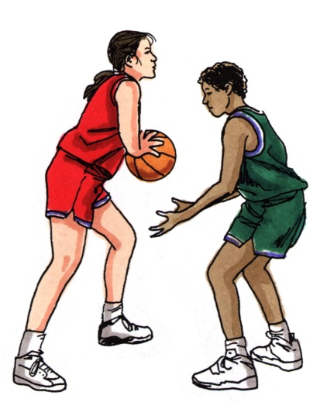
Reactive Aggression in Girls
Girls can exhibit social information processing deficits similar to those of boys
Nature of other girl anger forms may be qualitatively different from many boys
Relational aggression
Greater tendency to hold prolonged grudges

Slide 16
Screening and Assessment
History
Origins and current manifestation of problem
Previous attempts at intervention
How problem is currently managed, including known reinforcers and aversives
BASC-2 SDH is a good start
Psychological evaluation?
At least low average intellectual functioning
Understand any co-occurring conditions (e.g., ADHD, ODD, SLD, depression, trauma reaction)
Notes:
BASC Structured Developmental History (Pearson Publishing)

Slide 17
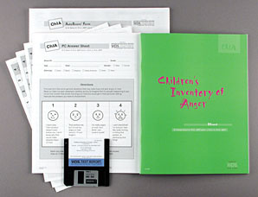
Anger Assessment Tools
Children’s Inventory of Anger (ChIA)
Self-report for children 6-16
39 Items, Total Score and four subscales
Frustration (FRUST)
Physical Aggression (PHYS)
Peer Relationships (PEER)
Authority Relations (AUTH)
See Flanagan & Allen (2005) in Refs

Slide 18
Multidimensional School Anger Inventory
http://www.michaelfurlong.info/msai/
Mike Furlong and Doug Smith

Slide 19
Progress Monitoring Baseline
Need to establish a behavioral baseline
How will we know it’s “working?”
What is he/she doing that is observable, measureable, and subject to change?
Authentic data from home or school
Increase something or decrease something
Disciplinary reports, home/school/unit point system
Classroom Progress Monitoring Report
Use of Direct Behavioral Assessment

Slide 20
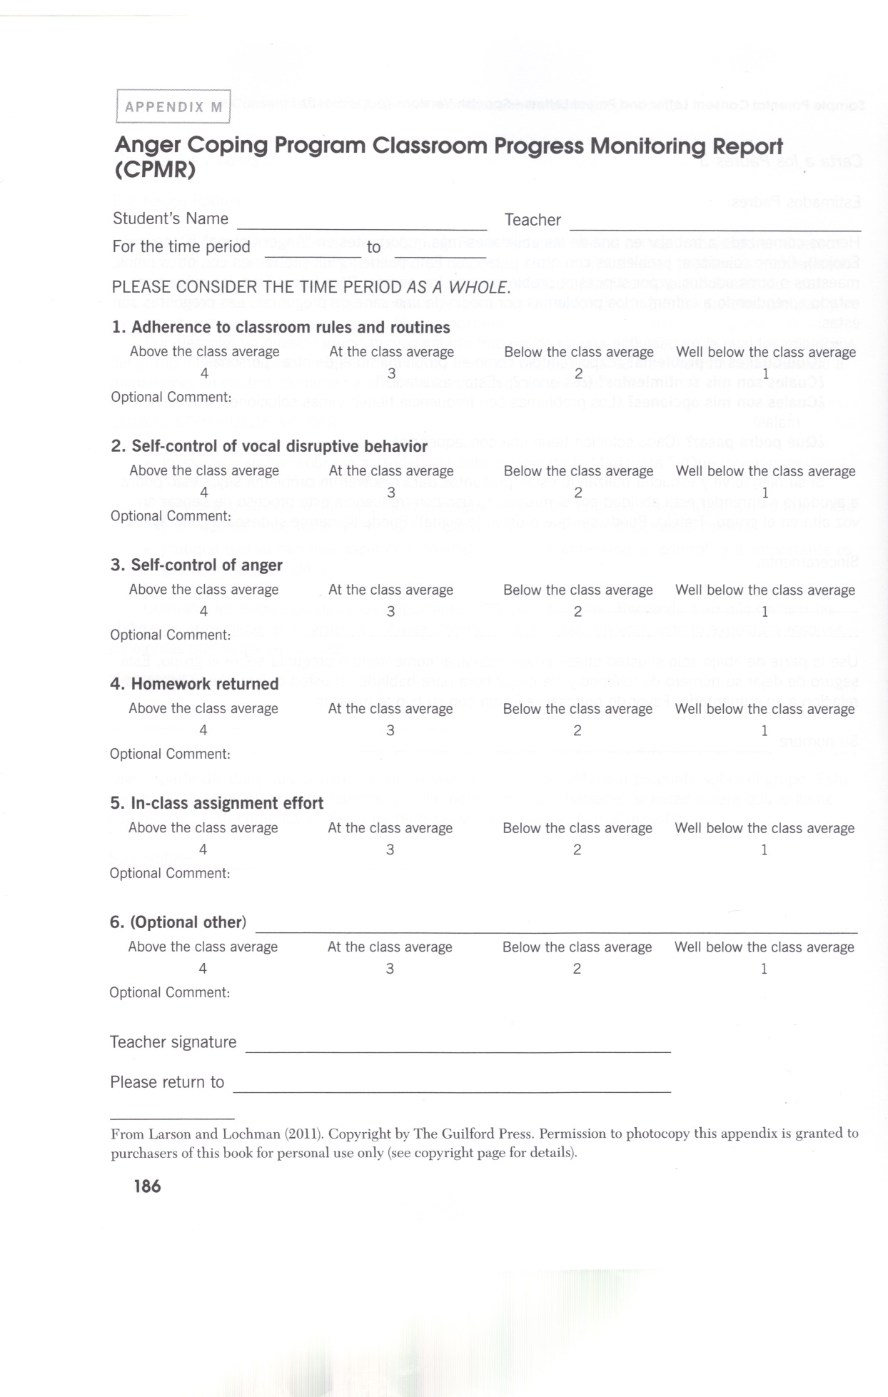
Classroom Progress
Monitoring Report

Slide 21
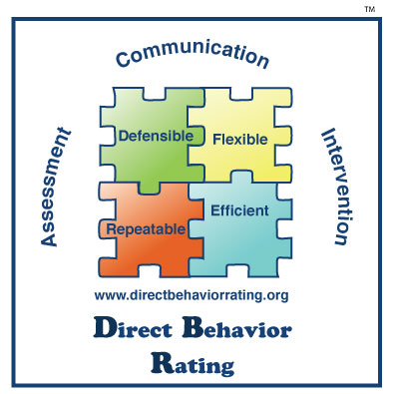
Direct Behavior Rating
http://www.directbehaviorratings.com/cms/

Slide 22
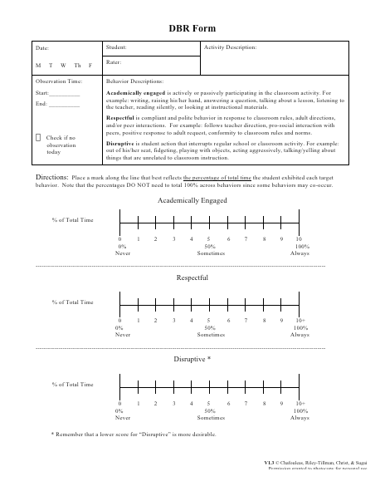

Slide 23
Monitoring Progress and Evaluating Outcomes
Goal Attainment Scaling
Percentage of Non-Overlapping Data (PND)

Slide 24
Goal Attainment Scaling
GAS Form for… Jim | Period covering… | Behavior…
+2 Much more than expected | 1 2 3 4 5 … | Jim has 1 or 2 violations of the playground rules in a five-day week
+1 Somewhat more than expected | 1 2 3 4 5… | Jim has 3 or 4 violations of the playground rules in a five-day week
0 Expected level of Outcome | 1 2 3 4 5 | Jim has 5 or 6 violations of the playground rules in a five-day week
-1 Somewhat less than expected | 1 2 3 4 5… | Jim has 7 or 8 violations of the playground rules in a five-day week
-2 Much less than expected | 1 2 3 4 5… | Jim has 9 or more violations of the playground rules in a five-day week

Slide 25
School Psychology Forum
VOLUME 3 • ISSUE 1 • PAGES 1–12 • Winter 2009
Goal Attainment Scaling: A Progress-Monitoring Tool for Behavioral Interventions
Gina Coffee
Loyola University Chicago
Corey E. Ray-Subramanian
Northern Illinois University

Slide 26
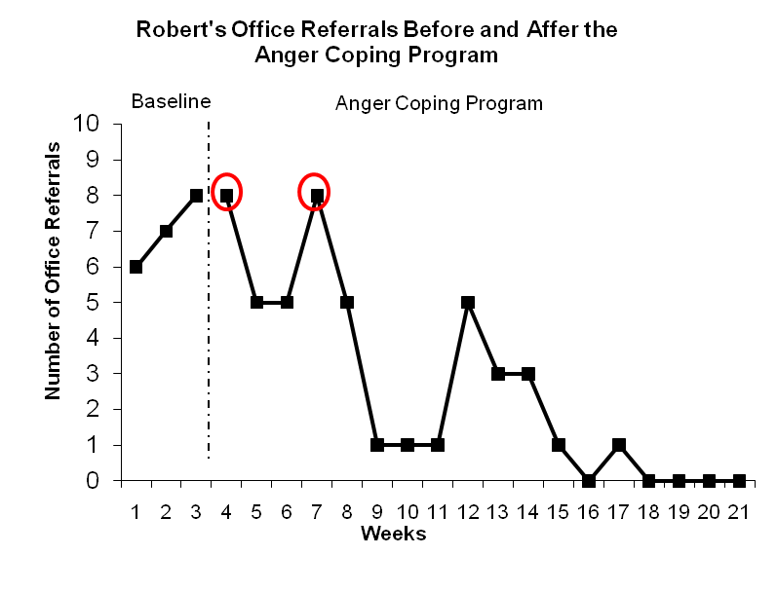
Sample PND
Obtain at least 3 data points in baseline phase
overlapping data
PND = 16/18 = 88.9%
PND of 90 or greater is considered highly effective, 70-90 moderately effective, 50-70 questionably effective, and 50 or lower is ineffective (Jenson, Clark, Kircher, & Kristjansson, 2007)

Slide 27
PND Tool
See Intervention Central’s
ChartDog Graphmaker at:
http://www.interventioncentral.org/tools/chart_dog_graph_maker

Slide 28
Anger Interventions Cognitive Behavioral Approaches
Donald Meichenbaum - CBT
Raymond Novaco - Adults
Eva Feindler - Adolescents
John Lochman - Children
Combines procedures from cognitive therapy (e.g., self-instruction, problem-solving) with operant behavior techniques (e.g., behavioral rehearsal, positive reinforcement)

Slide 29
Why Group Therapy?
Problems that have an EMOTIONAL component, such as managing anger, anxiety, or depression, require direct skills training
Involves out-of-class individual or group training by a skilled school psychologist
Groups allow for role-play and peer feedback

Slide 30
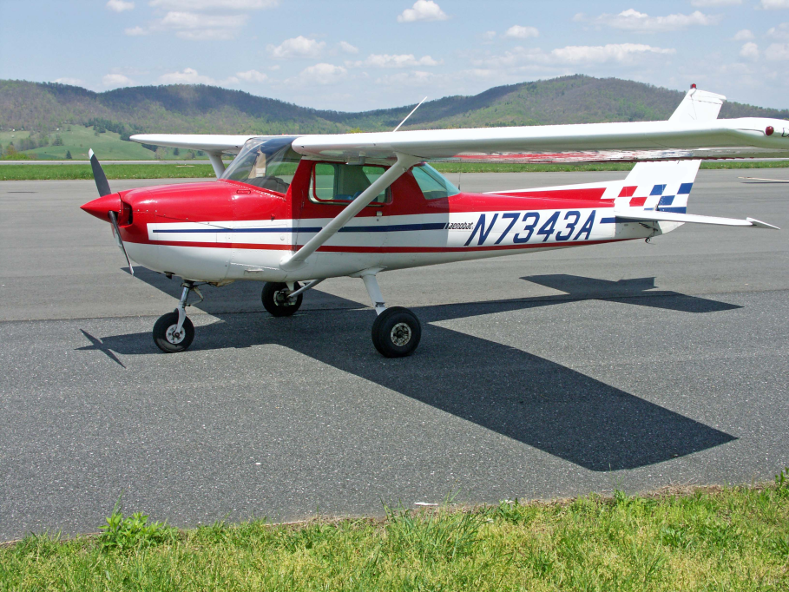
Training vs. Insight
Knowing about a new behavior is NOT the same as being able to enact that behavior under rapidly moving conditions of ambiguity and emotion

Slide 31
Anger Coping Program for Children Ages 8-14
Session 1: Introductions, Rules, Point System
Session 2: Goal Development
Session 3: Affective Education – What is Anger?
Session 4: Anger Cues – What Does Anger Feel Like?
Session 5: Anger Management – Puppet Self-Control Task
Session 6: Anger Management – Self-Instruction
Session 7: Problem-Solving – Definition and Choices
Session 8: Problem-Solving – Anticipating Consequences
Session 9: Problem-Solving – Behavioral Alternatives
Session 10: Video Production and Conclusion

Slide 32
Think First Anger and Aggression Management for Secondary Level Students
Multiple screening and identification procedures
5-7 boys or girls; 1 period/week; minimum 1 sem.
Five Modules, with Knowledge and Skill Outcomes
1. Personal Choice Behavior
2. Hassle Log and Anger Reducers
3. Anger Triggers and Attribution Retraining
4. Self-Instruction and Consequential Thinking
5. Social Problem-Solving
Booster sessions and maintenance plan

Slide 33
Problem-Solving Discourse
Strategies by Donald Meichenbaum for working with individual aggressive adolescents

Slide 34
Working with Individual Adolescents General Considerations
Establish collaborative relationship
How can we work together?
Respect the youth’s perspective
Get student to convince you of its authenticity
Take a solution-focused approach
Instill hope, a way out
Foster responsibility, ownership
Enact a plan

Slide 35
Problem-Solving Discourse (Meichenbaum, 2008)
A “Phase-Oriented Problem-Solving” process to help angry youth become better problem-solvers;
Follows a “discovery training” model
Helps teach a variety of coping skills and problem-solving vocabulary

Slide 36
Problem-Solving Discourse
PHASE I - PREPARATION
Collaborative alliance, defuse emotions, obtain timeline of aggressive event
PHASE II - PROBLEM-SOLVING PHASE
Consider and develop more prosocial alternatives and assume more responsibility
PHASE III - IMPLEMENTATION
Practice and apply new skills

Slide 37
PSD PHASE I - PREPARATION
If necessary, defuse the situation and de-escalate the anger
Explore the “what, when, where, who” of the present incident – “mental videotape”
Conduct a behavioral chain analysis that connects feelings, thoughts and behaviors
How did you feel when that happened to you?
What went through your mind at that point

Slide 38
PSD PHASE I - PREPARATION
Emphasize choice behaviors
How did you come to choose (decide) to do … ?
What happened after you made the choice to …?
Summarize student’s view of the event
Correct me I’m wrong, but what I hear you saying is…
Nurture hopefulness, a way out
Let's see if we can make sense of what happened to you

Slide 39
THIS VIDEO DEMONSTRATION…
Highly compressed timeframe
Remarkably cooperative client!
Watch/listen for major objectives
Thoughts and feelings connection
Moving locus of control inward
Taking perspective of other
Considering alternatives
Tender Ears Advisory…

Slide 40
PSD PHASE I - PREPARATION
What did you observe?
What more do you want to know about this youth?

Slide 41
PSD PHASE II - PROBLEM SOLVING
Help the client take the perspective of others
What was going through his head when he saw you?
If you were thinking that, would you have done the same thing?
Help the client generate causal explanations
Why do you think he got so mad about that?
What seemed to trigger the problem?
Everything was going okay until what?

Slide 42
PSD PHASE II - PROBLEM SOLVING
Help the client generate alternative solutions
What other ways are there to try to solve the problem?
Can you think of a different way so X wouldn’t happen?
Help the client notice warning signs
How can you (or others) tell when you are first getting upset ?
Foster responsibility (ownership)

Slide 43
PSD PHASE II - PROBLEM SOLVING
What did you observe?
What direction would you take now?

Slide 44
PSD PHASE III - IMPLEMENTATION
Covey a “challenge” and bolster self-confidence
This might be really difficult. Can you do it?
I believe you are mature enough to face this
Generate an action plan
What advice would you have for a friend who has this same problem?
What has worked for you in the past?
Help anticipate consequences
If you do…what do you think will happen?

Slide 45
PSD PHASE III - IMPLEMENTATION
Help anticipate barriers
Let’s suppose that…
How can you remind yourself to…?
Reinforce effort
Help youth see the connections between action and outcomes and how he/she will benefit
Why is it important for you to stay out of trouble?
Do you think you can teach what you have learned to someone else?

Slide 46
PSD PHASE III - IMPLEMENTATION
What directions should therapy take from here?
Who else might you want involved?

Slide 47
Downloads
The Problem Solving Discourse Manual is available for free download at TeachSafeSchools.org, a website of the Melissa Institute for Violence Prevention and Treatment to provide research-based school violence prevention procedures for educators:
http://www.teachsafeschools.org/problemsolving.html
All videos referenced in this workshop:
http://facstaff.uww.edu/larsonj/video.html
Click “?” first and follow directions

